Slide 1

CAPSTONE PROJECT ON FOOTBALL DATA ANALYSIS
KAYALVILI K G

Slide 2
OBJECTIVE :
The objective of the Football Data Analysis Project is to conduct an in-depth analysis of football data to extract actionable insights across multiple focus areas. This involves evaluating player and team performance, understanding player market value, analyzing team and player attributes, and uncovering patterns in attendance, referee decisions, substitutions, and events. The analysis will help address key business questions, support strategic decision-making, and leverage machine learning models where applicable.
PROJECT REQUIREMENTS :
TOOLS : ANACONDA , JUPYTER NOTEBOOK, TABLEAU, SQL WORKBENCH
DATA REQUIREMENTS : APPEARANCE , GAMES, GAMELINEUP, GAMEEVENT AND PLAYERS DATASET

Slide 3
DATA CLEANING AND MERGING
LOADING REQUIRED LIBRARIES
UNDERSTANDING THE DATASETS: .shape,.info(),.describe,dtypes,.isnull().sum() etc
DROPPING UNNECESSARY COLUMNS FROM DATASETS
IMPUTING THE MISSING VALUES USING MEDIAN AND MODE
FORMATTING THE DATATYPES OF THE COLUMNS IN DATASETS
USING MYSQLCONNECTOR LIBRARY, PUSHED ALL DATASETS TO THE SQL WORKBENCH
MERGED ALL DATASETS USING JOINS BY THE FOREIGN KEY COLUMN
CHECKED FOR NULL VALUES IN THE MERGED DATASET
DROPPED UNNECESSARY COLUMNS AND IMPUTED MISSING VALUES FOR THE MERGED DATASETS

Slide 4
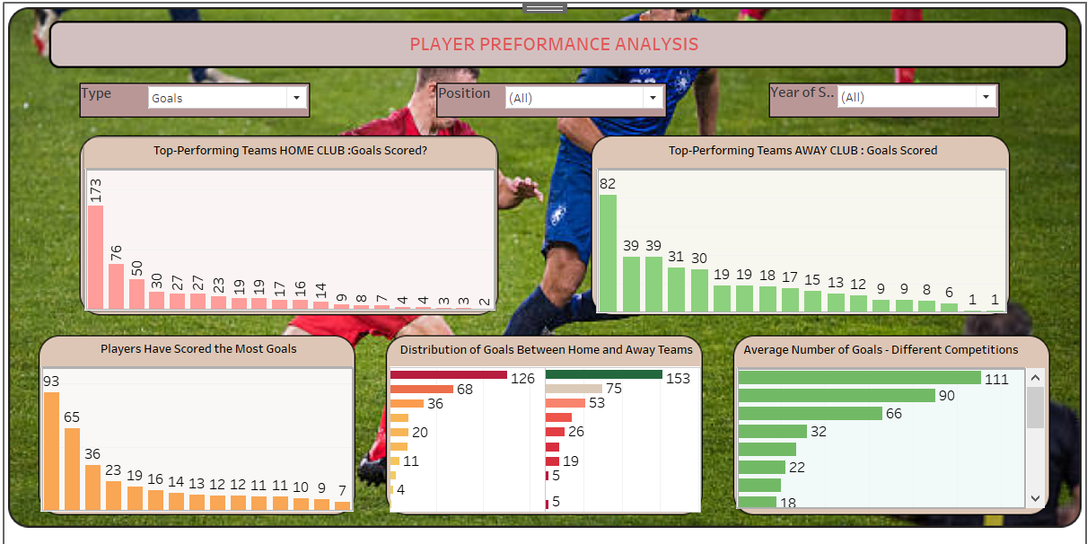
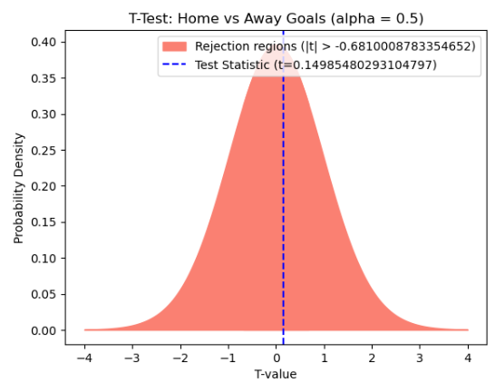
PERFORMANCE ANALYSIS
INTERPRETATIONS:
Player ARON JOHANNSSON - 93 and JOZY ALTIDORE - 65 goals.
Home club : BORUSSIA VEREIN (410 goals) and Away club : BORUSSIA DORTMUND (282 goals)
Player FABIAN JOHNSON has highest goals 317 in away and 436 in home teams.
Competition NL1 has 131 goals(highest) and CLQ has least No. of goals (1 goals).
Probability of home team winning a match is: 45%
Probability of a goal scored after a substitution is: 84%
Fail to reject the null hypothesis: There is no significant difference between home and away goals. Any observed difference (a difference of 0.35 goals per match) is likely a result of random sampling variability rather than a true underlying difference in performance between home and away teams.

Slide 5
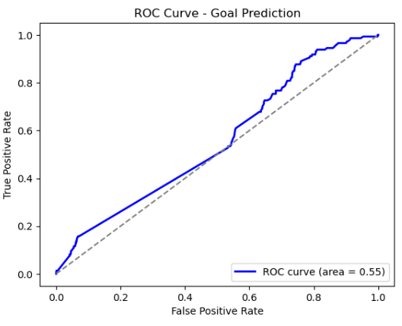
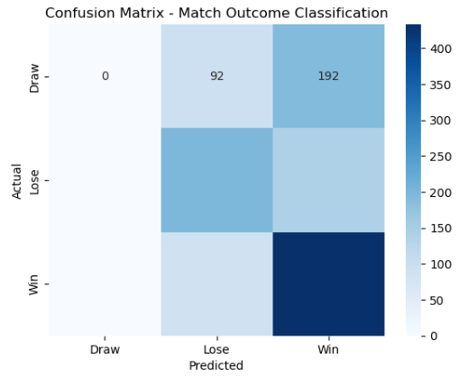
LOGISTIC REGRESSION
Goal Prediction: Accuracy of 87.2%, but ROC AUC – 0.55 : indicates weak performance in distinguishing between goal-scoring and non-goal-scoring instances.
Match Outcome Classification: Accuracy of 55%,but struggles significantly in predicting draws, as these are often misclassified as either wins or losses.
Both models show moderate to low performance, with clear issues in classifying key outcomes,

Slide 6
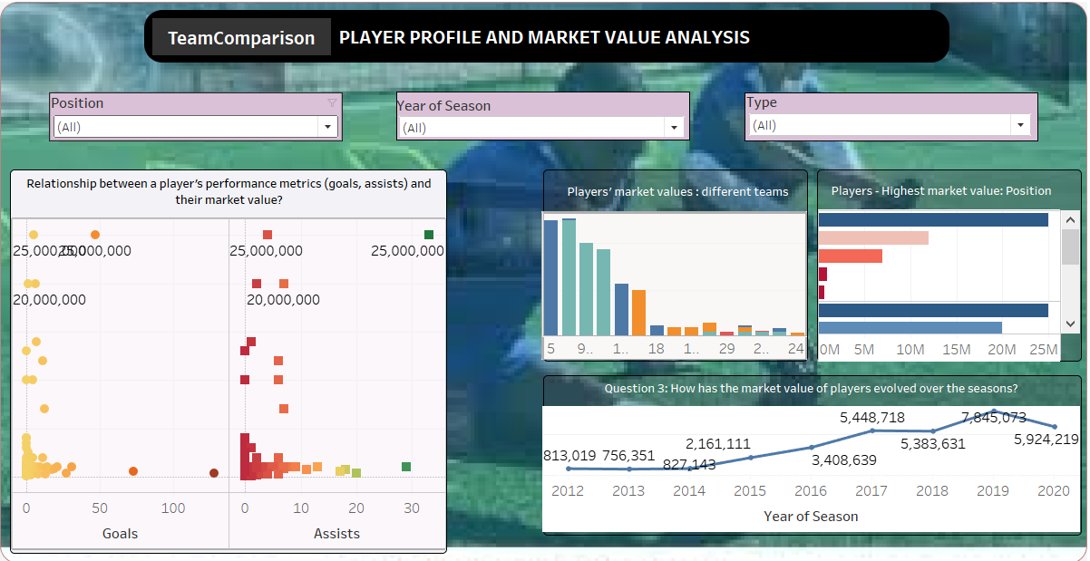
PLAYER PROFILE AND MARKET VALUE ANALYSIS
CLUB ID : 5 with 25M EUR and 16 with 22M EUR has the highest average market value.
ATTACK : CHRISTIAN PULISIC (25M EUR), MIDFEILD : GIOVANNI REYNA (25M EUR), DEFENDER : SERGINO DEST(10M EUR), GOALKEEPER: ZACK STEFFEN(3.5M EUR) has leading market value in each position.
IN 2012 – avg. market value 81K EUR and gradually increased over the years. IN 2019 peaking €7.85 million. 2020 dropped to €5.92 million.
CHRISTIAN PULISIC (25M EUR) has goals – 47 and 33 assists and GIOVANNI REYNA (25M EUR), has 5 goals and 4 assists. Correlation of the goals to market_value - 0.022801and assists to market_value - 0.079115.

Slide 7
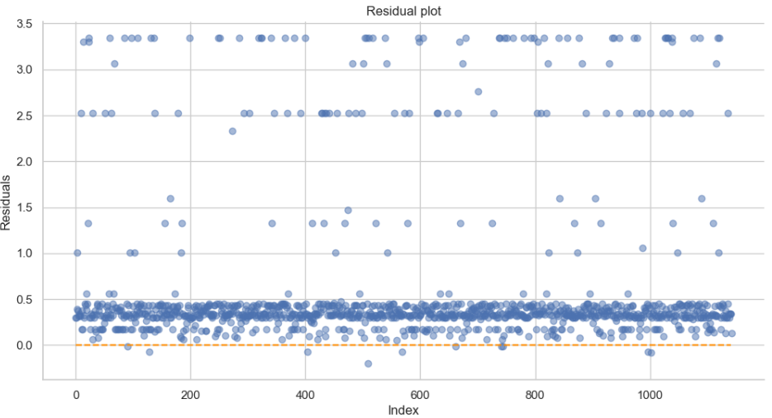
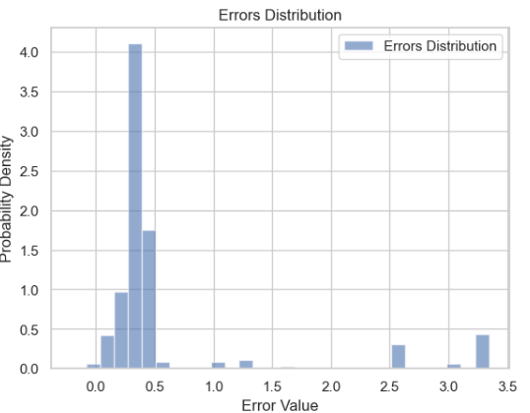
LINEAR REGRESSION MODEL
SIMPLE LINEAR REGRESSION MODEL
Independent variable - assists and Dependent variable - market value.
R² score of 0.0047
A weak relationship between assists and market value.
MULTIPLE LINEAR REGRESSION:
Dependent Variable: market_value_in_eur
Independent Variable: Goals, Assists, Minutes Played, yellow cards, red cards, position,height_in_cm
1 feature - R² Score: 0.0024MSE: 1.0925, RMSE: 1.0452, MAE: 0.6461
2 features - R² Score: 0.0027MSE: 1.0922, RMSE: 1.0451, MAE: 0.6461
3 features - R² Score: 0.0028MSE: 1.0921, RMSE: 1.0450, MAE: 0.6471
4 Features (Assists, Goals, Red Cards, Position) - R² Score: 0.0044MSE: 1.0903, RMSE: 1.0442, MAE: 0.6459
Error distribution showed that most residuals are tightly clustered between 0.0 and 0.5, prediction is accurate for large data’s.
The model’s error increases for certain data points (likely outliers).
The current set of features (goals, assists, minutes played, yellow cards, red cards, height, position) is not sufficient to build an accurate predictive model for market value.

Slide 8
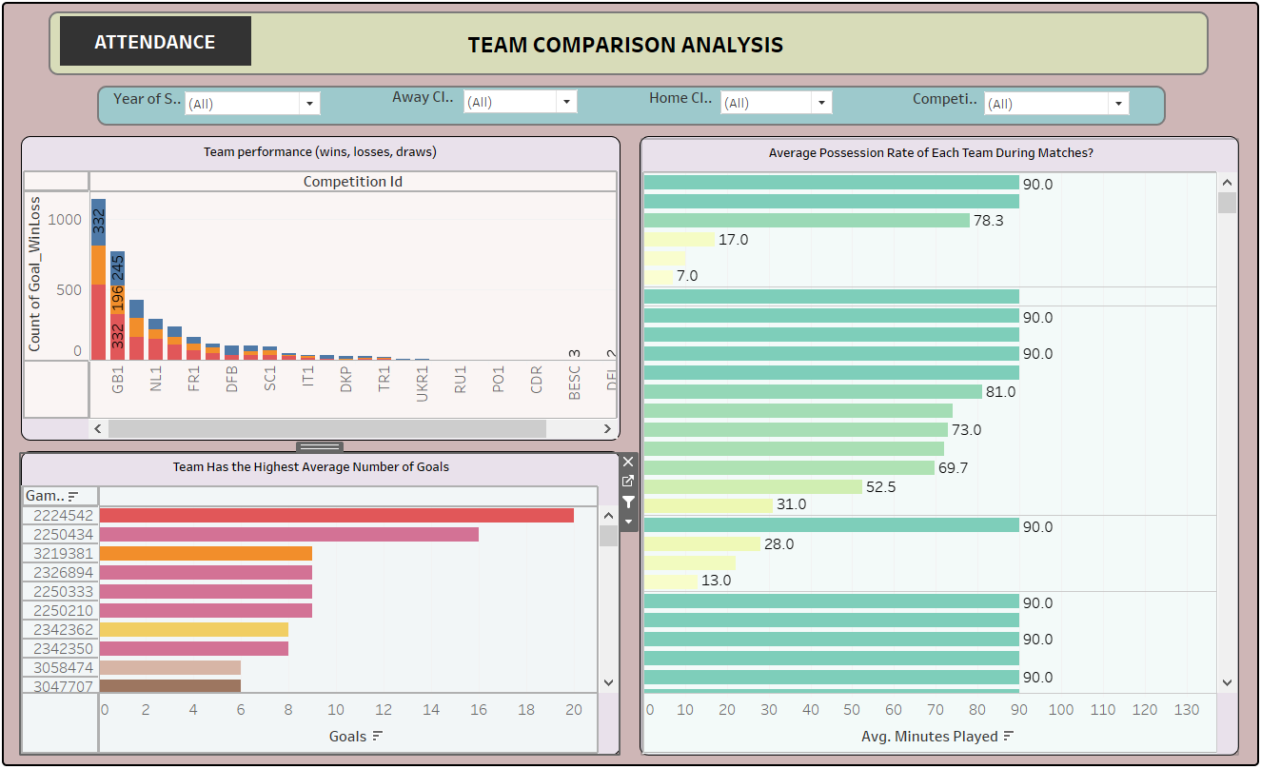
TEAM COMPARISION ANALYSIS
Away team – Aarhus Gymnastik Forening and Home team – AC Horsens has score 20 goals in a match 2224542
There are 536 home wins and 332 away wins for L1 competition ID (Highest).
(High possession rate )Avg. minutes played by teams 90 and least possession rate is 1 min.

Slide 9
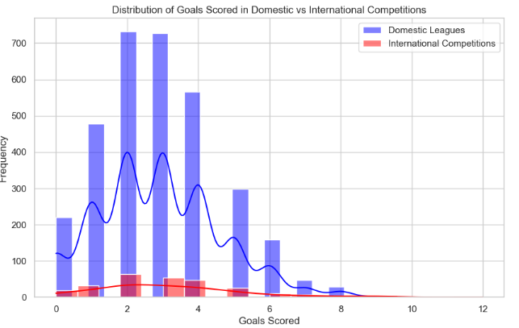
HYPOTHESIS TEST : GOALS SCORES
T-Statistic: 0.292 T-Critical Value: -0.681 Degrees of Freedom (DoF): 38 ,P-Value: 0.772
Conclusion: Fail to reject the null hypothesis. No statistically significant difference in goals scored.
The p-value indicates that any observed differences in sample means could have occurred by random chance, it may differ for different samples.

Slide 10
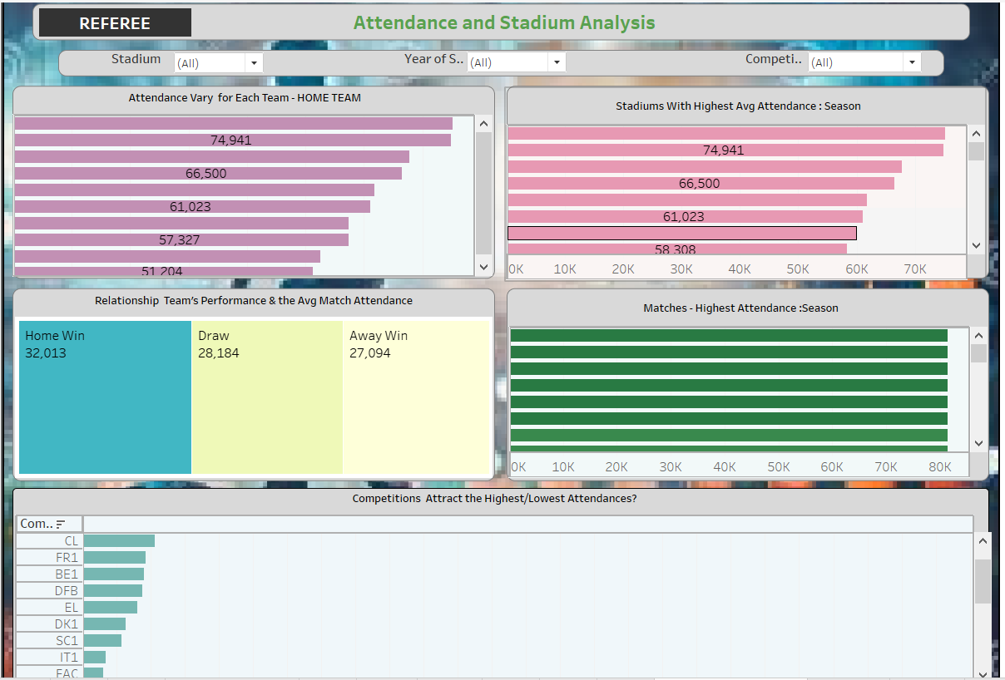
Attendance AND STADIUM ANALYSIS
STADIUM : OLD TRAFFORD has avg. attendance of 75134, followed by SIGNAL IDUNA PARK with 74,941 avg. attendance.
Away club: Sporting Clube de Portugal has highest avg. Attendance of 65,849.and Home club : Manchester United Football Club – 751334(avg. attendance)
The team with highest attendance has won the match : Home wins – Avg attendance: 32,013
Game ID – 3203640, 3203622,3203604,3203596 in the season of 2019 has the highest avg. Attendance of 81,365
Competition ID L1 – Avg. attendance 81,365

Slide 11
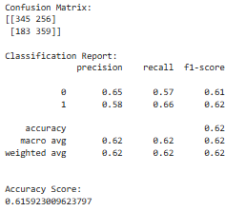
KNN CLASIFICATION
62% of the predictions made by the model are correct.
Correctly predicted 345 low attendance matches and 359 high attendance matches, while misclassifying 256 low attendance matches and 183 high attendance matches.
Precision and Recall: The model has a precision of 65% for low attendance and 58% for high attendance, with recall values of 57% and 66%, respectively, reflecting a better performance in identifying high attendance matches.
REQUIRES 30% IMPROVEMENT IN MODEL

Slide 12
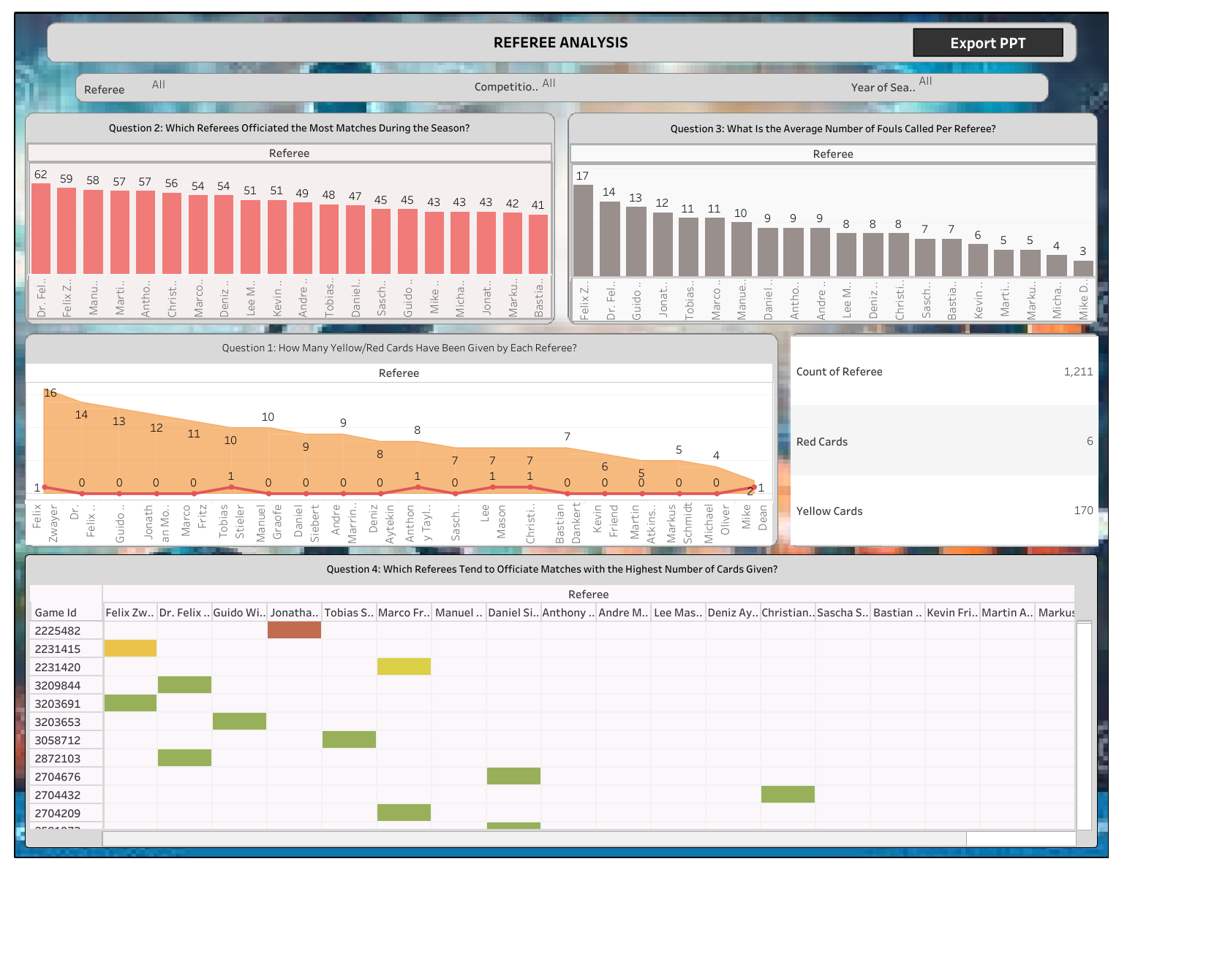
REFREE ANALYSIS
REFEREE : FELIX ZWAYER(Yellow cards -16,Red cards- 1) and followed by Dr. FELIX BRYCH (Yellow cards -14, Red cards – 0)
REFEREE : Dr. FELIX BRYCH(62 matches) and FELIX ZWAYER (59 matches) has officiated most matches.
REFEREE : FELIX ZWAYER(17 – foul cards) and Dr. FELIX BRYCH(14 – foul cards).
Jonathan Moss has given 6 foul cards for game id – 2225482

Slide 13
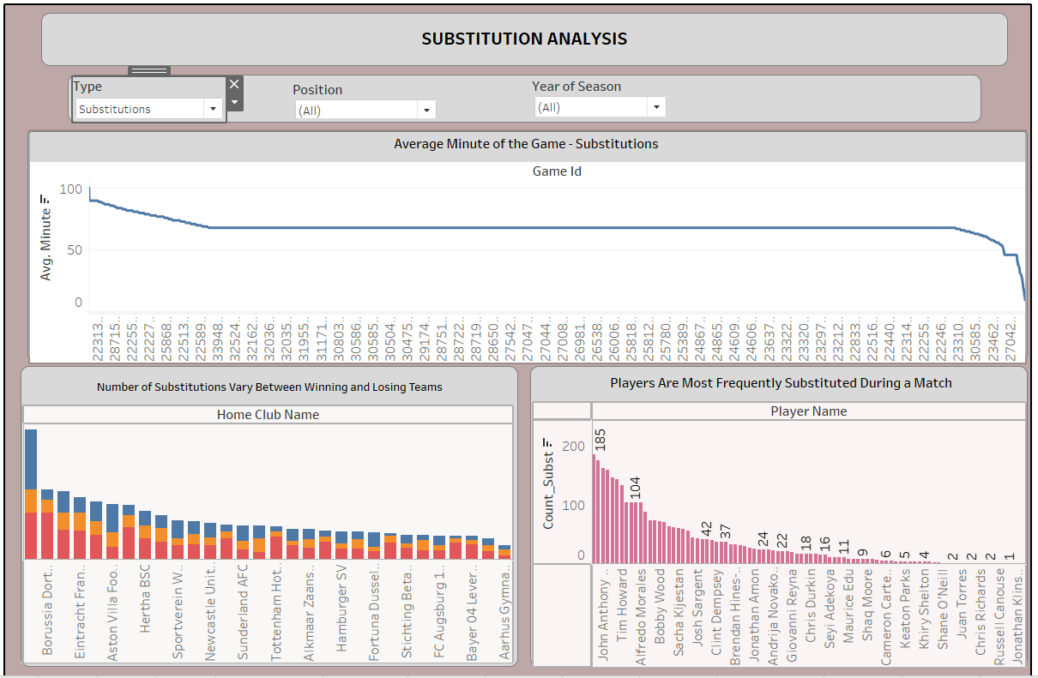
SUBSTITUTION ANALYSIS
Most of the substitutions are made in avg. minutes 90
The more substitutions are made the high possibility of the team winning. 70 substitutions-Home wins and 88 substitutions – Away wins (BOURSSIA VEREIN)
Fabian Johnson has the highest substitution count of 185, followed by Timothy Chandler with 175 substitution counts.
Attack position has the highest count of substitutions of 1027 followed by Defender with 965 substitutions

Slide 14
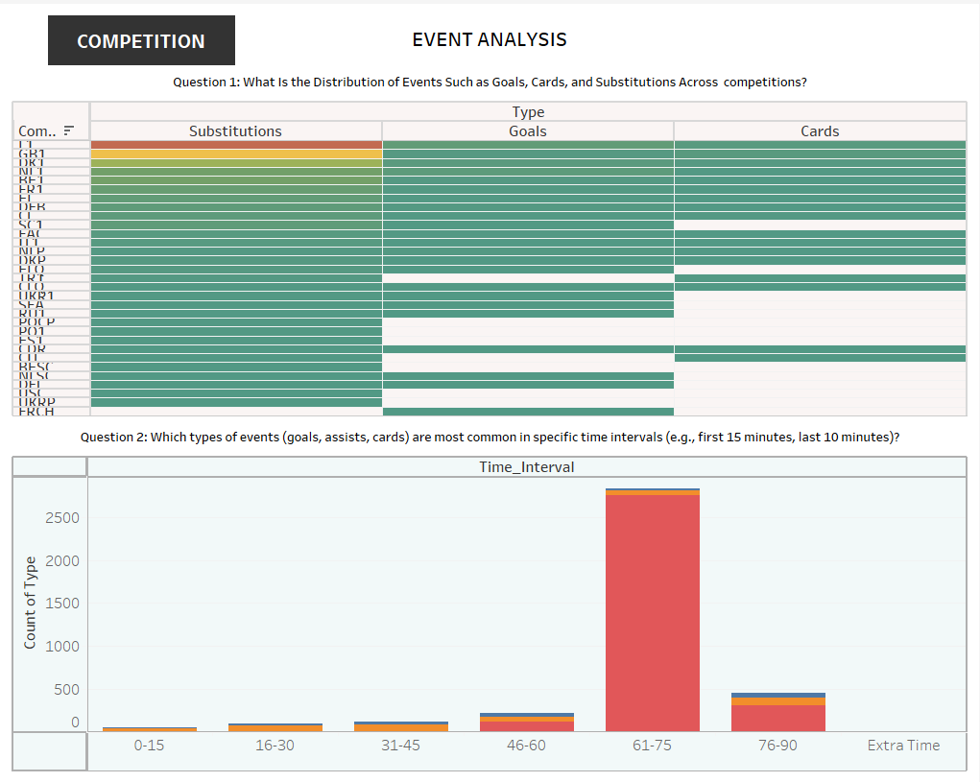
EVENT ANALYSIS
The competition ID L1 has the maximum No. Of substitutions (992), No. Of goals (104) and No. Of cards (47). And competition ID FRCH has the least No. Of goals(1).
At Time interval 61-75, 2749 substitutions were made, 33 goals and 175 assists.

Slide 15
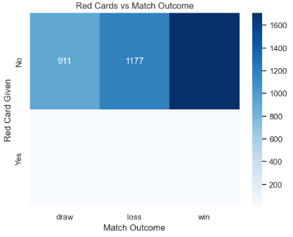
HYPOTHESIS TEST : EVENT ANALYSIS
Chi-Square Test Result: The chi-square statistic (0.21) and high p-value (0.90) indicate that there is no significant association between receiving a red card and losing a match.
Conclusion: fail to reject the null hypothesis, suggesting that receiving a red card does not significantly affect the likelihood of a team losing.

Slide 16
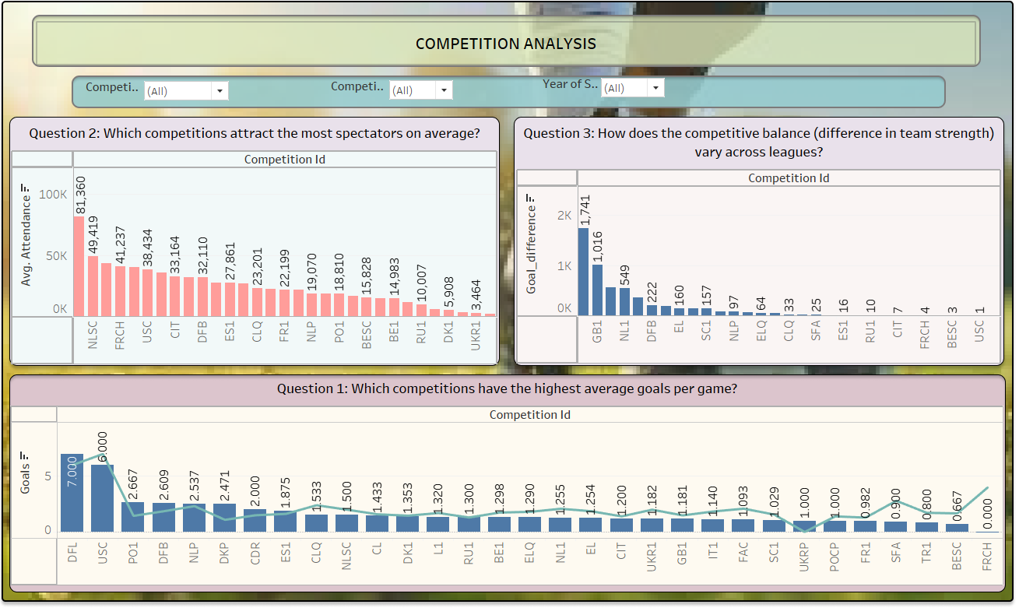
COMPETITION ANALYSIS
The highest average goals per game were observed in the USC (13.0) and DFL (13.0) competitions.
The DFL (81,360) and NLSC (49,418.5) competitions attracted the highest average attendance.
POCP (6) and USC (1) displayed the smallest average goal difference, indicating more competitive balance between teams.

Slide 17
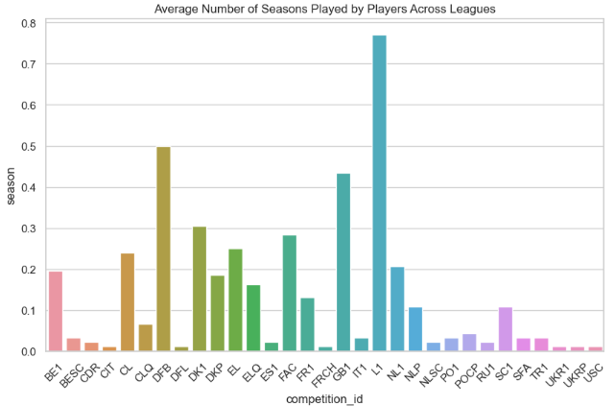
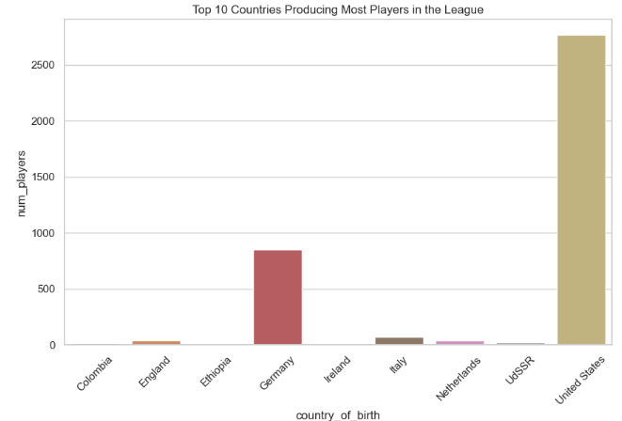
PLAYER ATTRIBUTES AND DEMOGRAPHICS
Attack, defender and midfielder are mostly from age of 20’s -30’s. Goalkeepers are from age of 20’s-40’s.
Goalkeepers have the tallest average height (around 195 cm),followed by defenders (around 190 cm)
Apprx. 80% of the teams prefer right foot during matches.
The United States produces the most players in the league,# with over 2500 players, followed by Germany with approximately 1000 players.
Highest average number of seasons played by players is observed# in League 1 (L1)

Slide 18
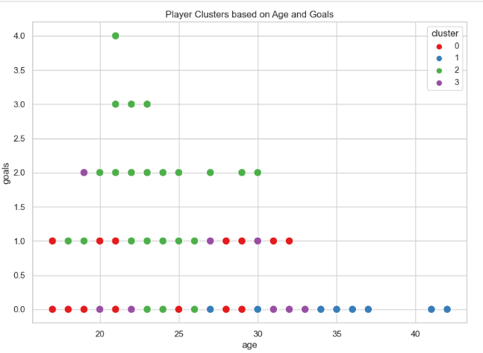
K-means CLUSTERING
The clustering reveals that younger players (below 30 years old) are distributed across all clusters, while older players (above 30) tend to cluster in lower performance categories.

Slide 19
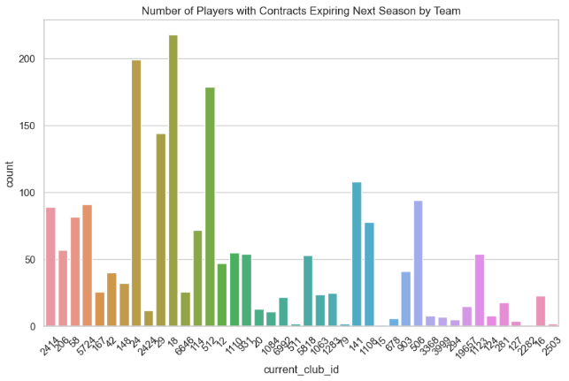
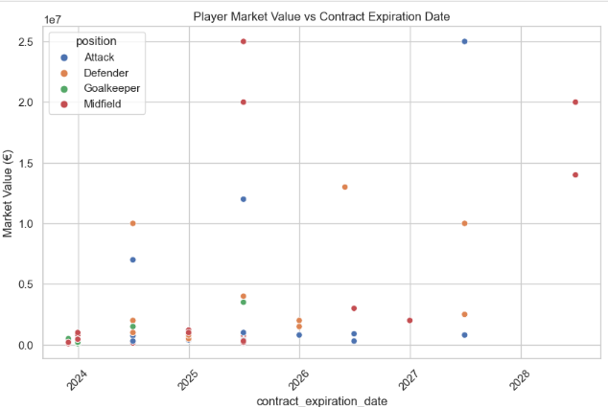
CONTRACT MANAGEMENT
Club IDs around 1084, 114, and 379, have notably longer contract lengths.
The team with the ID '18' has the highest number of expiring contracts, over 200 players and followed by Club ID ’24’ has 190 players with expiring contracts.
The highest market value observed exceeds €25 million for a midfielder with a contract expiring in 2026.

Slide 20
CONCLUSION
Performance Analysis
Players: Aron Johannsson scored 93 goals, and Jozy Altidore scored 65, with Fabian Johnson having a record of 317 goals for away teams and 436 for home teams.
Teams: Highest goals scored were by BORUSSIA VEREIN (410 goals) and Away club : BORUSSIA DORTMUND (282 goals)
Competitions: NL1 led with 131 goals; CLQ had the least, with 1 goal.
Statistical Testing: A two-sample t-test showed no significant difference between home and away goals, implying that goal variance may be due to random chance.
Model accuracy for identifying significant contributors can be enhanced by 15% through additional features such as player form and match conditions.
Goal and Match Outcome Prediction
Goal Prediction: Achieved 87.2% accuracy; however, an AUC-ROC of 0.55 shows poor differentiation in goal and no-goal events.
Match Outcome Prediction: An accuracy of 55%, with difficulty predicting draws, reflects moderate performance and room for improvement in modeling.
Goal prediction requires a 20% improvement, primarily in ROC-AUC, to better distinguish scoring events. Match outcome prediction requires a 30% improvement, with a focus on feature engineering (e.g., match context and player fatigue).
Market Value and Player Profile
Highest market values are observed in Club IDs 5 (€25M) and 16 (€22M). Key players include Christian Pulisic (€25M) and Giovanni Reyna (€25M).
Regression Models: Linear regression models linking assists and goals with market value reveal low R² values, indicating weak relationships between these variables and market value.
Adding features like market trends, fan engagement, and age could boost predictive accuracy by up to 40%.

Slide 21
Winning Statistics: Aarhus Gymnastik Forening and Home team – AC Horsens have notable goals-per-game averages.
Possession Rates: Matches display high possession times averaging 90 minutes, showing consistent team engagement.
Hypothesis Testing - Goal Scoring
With a t-statistic of 0.292 and a p-value of 0.772, the analysis found no significant difference in goals scored, suggesting scoring variance is likely random.
Model accuracy can be improved by 10% with enhancements in data contextualization (e.g., recent form, injuries, tactical changes).
Team Comparison
Attendance and Stadium Analysis
Top Stadiums : Old Trafford averages 75,134 attendees per game; Signal Iduna Park, 74,941.
Higher attendances correlate with higher home game win rates.
KNN CLASIFICATION
Model reliability can improve by 10% by adding variables related to fan engagement and opponent strength.
To reach 75% accuracy, consider improving model features by 25%, focusing on factors like team performance, fan engagement, and weather.
With a precision of 0.65 for low attendance and 0.58 for high, KNN predictions accurately identify high-attendance events better than low-attendance ones, though model improvement is needed.To reach 75% accuracy, consider improving model features by 25%, focusing on factors like team performance, fan engagement, and weather.

Slide 22
Referees: Felix Zwayer and Dr. Felix Brych officiated the most games, impacting yellow and red card distributions.
Event Timing and Analysis
Competition and Player Demographics
Referee and Substitution Analysis
Substitutions: Teams making more substitutions tend to increase their winning chances, with 70 substitutions linked to home
Enhance model insights by 15% with additional referee-specific metrics (e.g., referee’s experience and style) and substitution timing.
Key substitutions and events occur most frequently between minutes 61-75, coinciding with tactical changes that can influence game outcomes.
Model refinement can improve by 10% with focus on tactical event timing in various match contexts
Player demographics show a trend of younger players in top-performance clusters, with right-foot dominance in gameplay.
USC and DFL competitions have the highest average goals and attendance.
Enhance analysis by 10% through deeper segmentation (e.g., analyzing player age and footedness by specific roles or performance tiers).
Enhance analysis by 10% through deeper segmentation (e.g., analyzing player age and footedness by specific roles or performance tiers).

Slide 23
BUSINESS RECOMMENDATIONS:
Player Performance & Recruitment: High-performing players and adaptable team tactics are key. By scouting versatile players and adjusting strategies based on game venues, teams can improve overall success, especially at home games.
Predictive Modeling: While we’re getting accurate predictions on goals, there’s room to better predict game outcomes by enhancing the model. This involves adding more relevant features and exploring different algorithms to improve reliability, especially for draws.
Market Value & Economic Factors: Player market values aren’t solely based on goals or assists. Including factors like fan appeal and economic conditions can make player valuations more accurate, helping the club manage contracts and investments wisely.
Attendance & Fan Engagement: Higher attendance generally correlates with better home team performance. Improving the fan experience can boost attendance and give teams a stronger home advantage, which is also beneficial for ticket sales and brand loyalty.
Team and League - Level Strategies: Insights show that teams in some leagues have a stronger home advantage, so encouraging bold play styles at home could lead to more wins. Similarly, promoting high-scoring leagues and competitions can capture audience interest and attract sponsors.
Event Timing & Substitutions: Timing plays a huge role in-game events, like scoring or substitutions, which often peak mid-match. Teams can benefit from making tactical moves around these peak times, as well as using substitutions strategically to maintain momentum.
Refereeing and Officiating: Knowing each referee’s style can help match planners ensure fair play by assigning strict referees to high-stakes matches, promoting a balanced game environment.
Contract Management: High turnover rates in player contracts can lead to team instability. Managing contracts proactively and having backup rosters in place can help maintain consistency and avoid disruptions in performance.

Slide 24
THANKYOU

